Slide 1
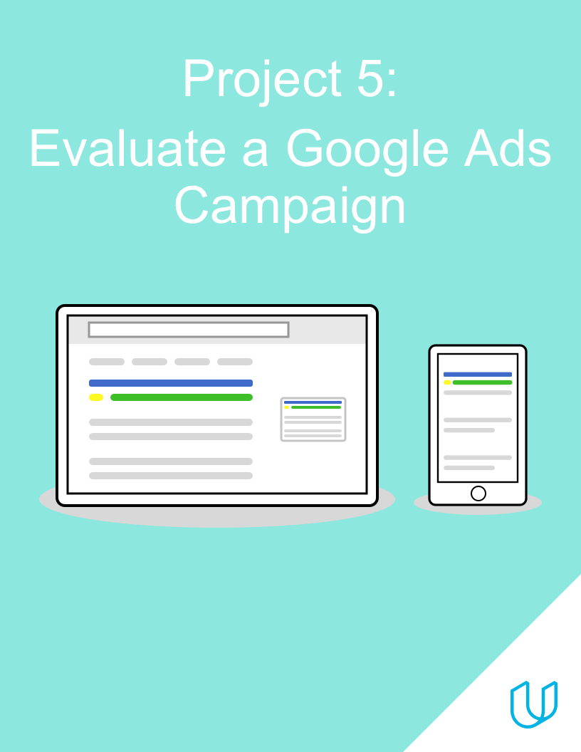

Slide 2
Campaign Approach
Description and Marketing Objective

Slide 3
1. Campaign Approach
2. Marketing Objective
Udacity has launched a campaign to advertise for the Digital Marketing Nanodegree Program
The campaign is divided into two ad groups, one targeting customers in the Awareness stage and one targeting customers in the Interest stage
Each ad group uses responsive search ads, with multiple options for the ad headline and description
When users click on an ad, they are taken to the overview page for the Digital Marketing Nanodegree Program, where they can click a button to download the program syllabus. This conversion has an estimated value of $5.
The campaign’s marketing objective is to gather at least 200 conversions (syllabus downloads), with a conversion rate of at least 10%

Slide 4
Ad Groups
Ads and Keywords

Slide 5
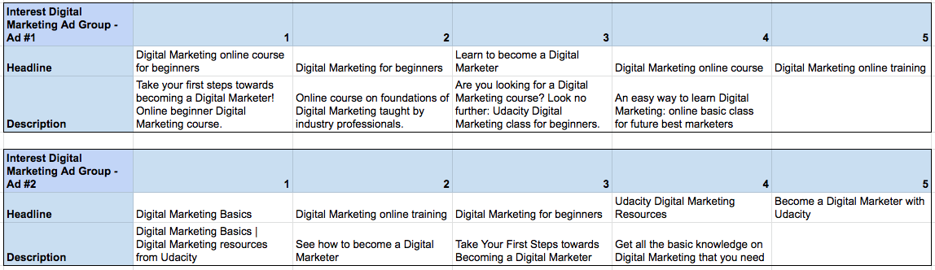
Ad Group #1: Ads
Data is also available in this spreadsheet

Slide 6
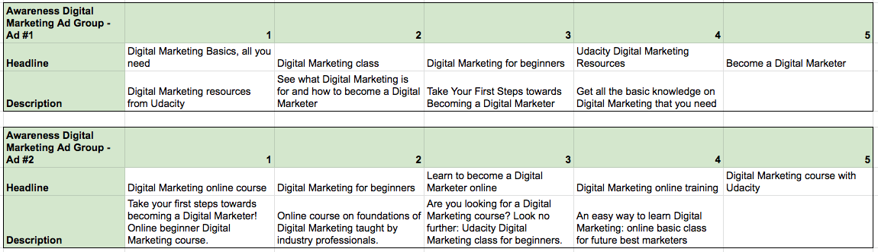
Ad Group #2: Ads
Data is also available in this spreadsheet

Slide 7
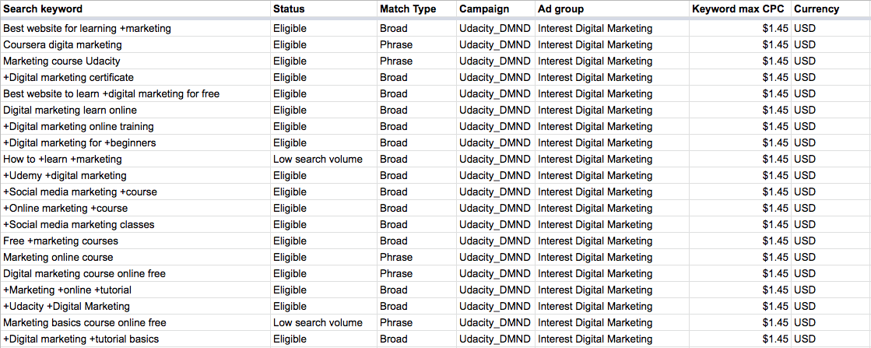
Ad Group #1: Keywords
Data is also available in this spreadsheet

Slide 8
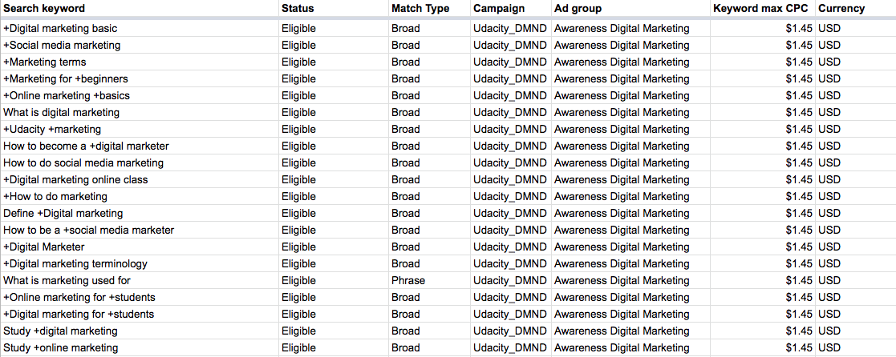
Ad Group #2: Keywords
Data is also available in this spreadsheet

Slide 9
Campaign Evaluation
Results, Analysis and Recommendations

Slide 10
Key Results (Campaign)
Expand the table below to identify and fill in any campaign-level KPIs/metrics you feel will be relevant to your evaluation of the campaign’s performance
Campaign | Cost | Clicks | Impressions | Conversions | cost per click | click through rate | cost per thousand impressions | cost per conversion | conversion rate
Udacity_DMND | $1,314.00 | 2391 | 111256 | 221 | $0.55 | 2.15% | $11.81 | $5.95 | 9.24%
Campaign data is also available in this spreadsheet
To add columns to your table, right-click where you want to add the column and select either “insert column left” or “insert column right”

Slide 11
Key Results (Ad Groups)
Expand the table below to identify and fill in any ad group-level KPIs/metrics you feel will be relevant to your evaluation of the campaign’s performance
Ad Group | Cost | Clicks | Impressions | Conversions | cpc | click through rate | cost per conversion | conversion rate | cost per thousand impression
Ad Group 1: Interest Digital Marketing | $819.05 | 1553 | 72497 | 132 | $0.53 | 2.14% | $6.20 | 8.50% | $11.30
Ad Group 2: Awareness Digital Marketing | $494.95 | 838 | 38759 | 89 | $0.59 | 2.16% | $5.56 | 10.62% | $12.77
Total | $1,314.00 | 2391 | 111256 | 221 | $0.55 | 2.15% | $5.95 | 9.24% | $11.81

Slide 12
Key Results (Ads)
Expand the table below to identify and fill in any ad-level KPIs/metrics you will be relevant to your evaluation of the campaign’s performance
Ad | Cost | Clicks | Impressions | Conversions | Cost per click | Click through rate | Cost per conversion | Conversion rate | Cost per thousand impression
Ad Group 1, Ad 1 | $458.25 | 991 | 40163 | 97 | $0.46 | 2.47% | $4.72 | 9.79% | $11.41
Ad Group 1, Ad 2 | $360.80 | 562 | 32334 | 36 | $0.64 | 1.74% | $10.02 | 6.41% | $11.16
Ad Group 2, Ad 1 | $335.60 | 619 | 28827 | 72 | $0.54 | 2.15% | $4.66 | 11.63% | $11.64
Ad Group 2, Ad 2 | $159.35 | 219 | 9932 | 16 | $0.73 | 2.20% | $9.96 | 7.31% | $16.04

Slide 13
Key Results (Keywords)
Campaign | Ad group | Keyword max CPC | Currency | cost | Clicks | Impressions | Conversions | cost per click | CTR | C/C | CR | CPTI
Udacity_DMND | Interest Digital Marketing | $1.45 | USD | $317.10 | 534 | 26639 | 65 | $0.31 | 2.00% | $4.88 | 12.17% | $11.90
Udacity_DMND | Interest Digital Marketing | $1.45 | USD | $36.00 | 66 | 912 | 10 | $0.43 | 7.24% | $3.60 | 15.15% | $39.47
Udacity_DMND | Interest Digital Marketing | $1.45 | USD | $23.10 | 48 | 894 | 8 | $1.41 | 5.37% | $3.08 | 15.63% | $25.84

Slide 14
Campaign Evaluation
The campaign’s return on investment (ROI), including identification of whether the campaign was ROI-positive or ROI-negative
ROI = (total conversion value - total cost)/total cost Conversion value *total cost-total cost/total cost
(221*5)-$1314.00/$1314.00
=1105-$1314/$1314
=-0.159~ - 0.16 the ROI Shows a negative value of -0.16 which indicates the loss of money for the campaign.

Slide 15
Campaign Evaluation
KPI FOR CAMPAIGN LEVEL.
Cost per click: cost / click = $1314.00/5 = $0.55
Click through rate: no of click/impression = 2391/111256 = 2.15%
Cost per conversion: total cost / conversion = $1314.00/ 221= $5.95
Conversion rate:no of conversion /no of clicks=221/2391=9.24%
Cost per thousand impression:cost/impression*1000=$1314.00/111256*1000=$11.81
KPI FOR AD GROUP LEVEL
AD GROUP 1-
Cost per click = $819.05/1553 =$0.53
Click through rate: 1553/72497= 2.14%
Cost per conversion: $819/132 = $6.20
Conversion rate:132/1553=8.50%
Cost per thousand impression:$819.05/72497*1000=$11.30
AD GROUP 2-
Cost per click= $494.95/838 =$0.59
Click through rate= 838/38759=2.16%
Cost per conversion=$494.95/89= $5.56

Slide 16
KPI FOR AD LEVEL
AD GROUP 1 AD 1
Cost per click: $458.25/991 = $0.46
Click through rate: 991/40163 = 2.47%
Cost per conversation: $458.25/97 = $4.72
Conversion rate: 97/991=9.79%
Cost per thousand impression:$458.25/40163*1000= $11.42
AD GROUP 1 AD 2
Cost per click: $360.80/562 =$0.64
Click through rate: 562/32334= 1.74%
Cost per conversion: $360.80/36= $10.02
Conversion rate:36/562=6.41%
Cost per thousand impression:$360.80/32334*1000=$11.16
AD GROUP 2 AD 1
Cost per click: $335.60/ 619= $0.54
Click through rate: 619/ 28827= 2.15%
Cost per conversion: $335.60/72=$4.66
Conversion rate:72/619=11.63%
Conversion rate:
Cost per thousand impression:

Slide 17
Campaign Evaluation
Cost per thousand impression:$335.60/28827*1000=$11.64
AD GROUP 2 AD 2
Cost per click: $159.35/ 219 = $0.74
Click through rate: 219/ 9932= 2.20%
Cost per conversion: $159.35/ 16 =$9.96
Conversion rate:16/218=7.31%
Close per thousand impression:$159.35/9932*1000=$16.04
AD GROUP 2 CONT’
Conversion rate:89/838=10.62%
Cost per thousand impression:$494.95/38759*1000=$12.77

Slide 18
KPI FOR KEYWORD LEVEL
KEYWORD1
Cost per click: $317.10/534 = $0.31
Click through rate:534/26639 = 2.00%
Cost per conversion: $317.10/65 = $4.88
Conversion rate:65/534=12.17%
Cost per thousand impression:$317.10/26639*1000=$11.90
KEYWORD 2
Cost per click: $36.00/66 = $0.43
Click through rate: 66/912 = 7.24%
Cost per conversion: $36.00/10 = $3.60
Conversion rate:10/66=15.15%
Cost per thousand impression:$36.00/912*1000=$39.47
KEYWORD 3
Cost per click: $23.10/ 48 = $1.41
Click through rate: 48/894 = 5.37%
Cost per conversion:23.10/8 = $3.08
Conversion rate:8/48=15.63%
Cost per thousand impression:$23.10/894*1000=$25.84

Slide 19
KEYWORD PERFORMANCE
+Online marketing +course
Social media marketing +course
+Digital marketing certificate
Based on the marketing objective stating this selected keywords conversion rate is higher than the stipulated value given as 10% ,their conversion rate was 12.17%,15.15%,15.63% respectively
The cost per conversion has also been at it's best the keywords has generated , a lower cost per conversion which is good since the marketing objective started that the conversion had an estimated value of $5
Based on the kpi calculation the keyword that is subject to high competition in Google ads is the keyword that has the highest cost per click value ,a lot of advertiser bid for the key word. The cost per click was $1.41
The campaign was successful and the conversion had an estimated value of $5 and the campaign was able to gather 221 conversion the campaign had a high rate of conversion at the keyword level.

Slide 20
Recommendations for future campaigns
I would focus on Ads and keywords both to bring about a successful campaign The keyword has to be attractive do as to increase the numbers of click and increase conversion rate.
I would change head line 5 to digital marketing online course and the description will be build your career in digital marketing with Udacity today and for headline 5 I would change it to learn the basics of digital marketing online and the description would be digital marketing online course within a month with intense training and certification
I would change +social media marketing+course+Udacity+Undergraduate this key word will attract undergraduate and graduate alike who are looking to branch into another career an opportunity with which Udacity will provide a learning environment for online

